Slide 1
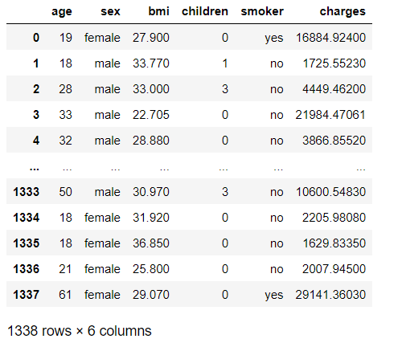
Data set has 1338 rows ,and 6 columns Note: By using shape attribute we can able to get the rows and columns count
Problem Statement:
Insurance charges Prediction
Read the dataset and Retrieve the columns present in the dataset:

Slide 2
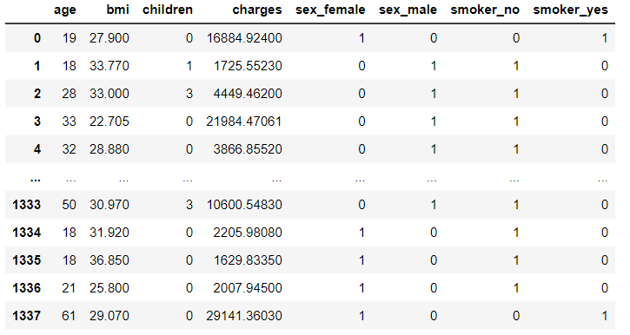
In our dataset we found that the some columns values are in string .So we performed the One hot encoding using get_dummies function.
Performed One hot Encoding:

Slide 3
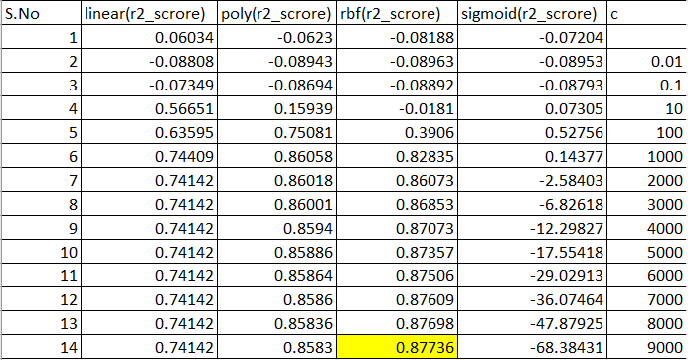
Machine Learning Algorithm:
Multiple Linear Regression:
R2_score value : 0.78947
SVR :
SVR (RBF with C=9000) has the
R2_score value : 0.87736

Slide 4
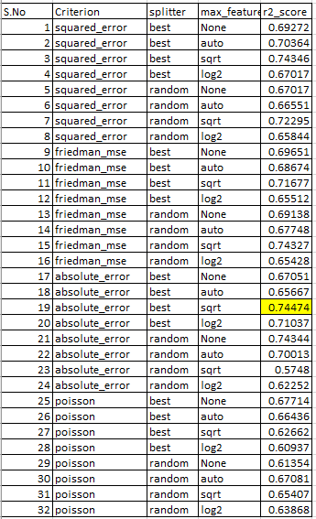
Decision Tree
Decision Tree (Criterion: Squared Error,Splitter:best,max_feature:sqrt) has the
R2_Score :0.74474

Slide 5
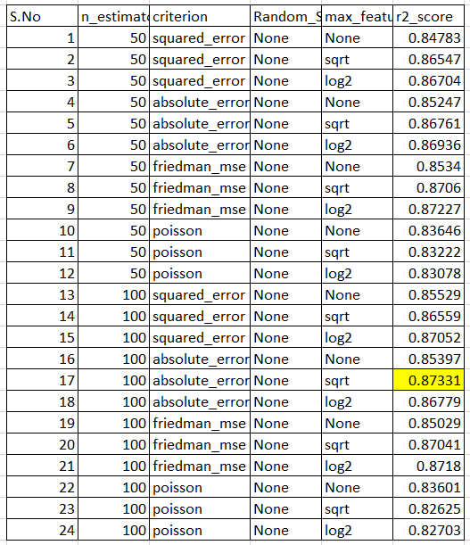
Random Forest:
The Random Forest Regression has the
R2_Score value :0.87331

Slide 6
Conclusion:
comparison of Multiple Linear Regression, SVR, Decision Tree, Random Forest:
The Multiple Linear Regression and Decision Tree models are not performed well.
Because R2_score value is lesser than 80%.
Even though Support vector Machine, Random Forest has the r2score value below 90%. I
have tuned these models , but the r2_score is not reached 90% or above.
The R2_Score value= 0.87 are same in both Support vector Machine, Random Forest.
So that I am considering as these two models performed good. Based on this we can choose either SVM or Random Forest.

